Slide 1
BM C4W
Eduardo Ortega

Slide 2
Procedures and More Information
Power Up Order
LEDs
Microcontrollers
Each Throne
4 ESP32, 4 Power Jacks for LED PANELS
8 outlets per Throne (24 total)
Compass
1 ESP32, 1 Power Jack for LED Strip
Debug Recommendations
Q1: LED Panel not turning on?
A1: Issue with Power Supply, etc.
Q2: Is LED animation not flowing to the right side of the panel?
A2: The data line is not getting signal make, which might need replacing. Wiggle the LED strip gently to see if that will help (it does).
Q3: Do you smell smoke?
A3: Turn EVERYTHING off and get Eduardo.
Q4: When do we turn on/off the electronics?
A4: Sunset/Sunrise

Slide 3
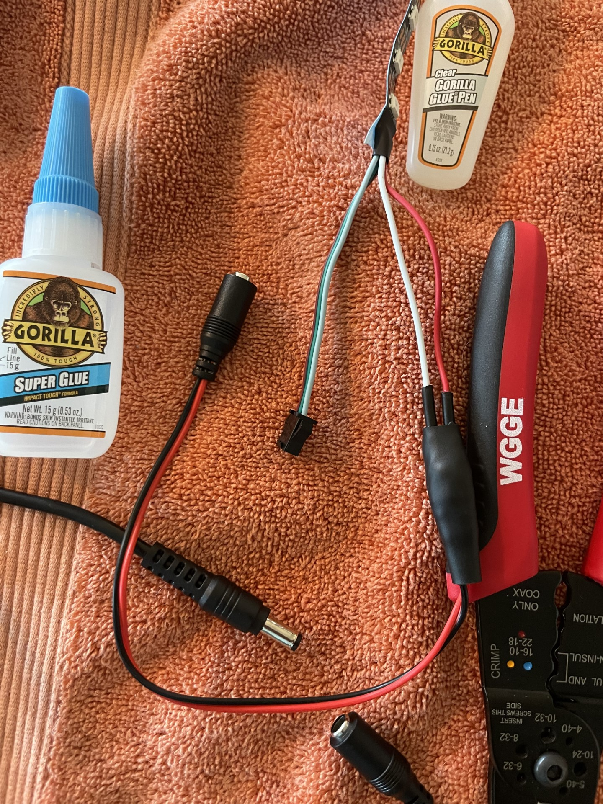
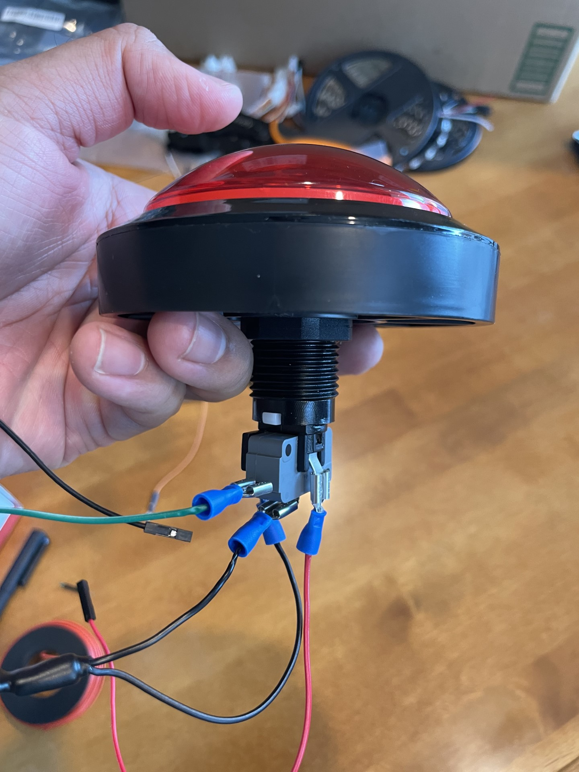
Progress Thus Far (8/3)
Electronics Progress
% of est. work
LED Panel | LED Cutting (25%) | Wiring (50%) | Gluing (20%) | Protect (5%)
NO (9%) | Done | Done | Done
YES (14%) | Done | Done | Done
WAIT (18%) | Done | Done | Current
MAYBE (22%) | Done | Done
Totems (x4) (37%) | Done
% of
LED strips
Power Connection
Software Progress
LED Animation
All code has been ported to the new library
Interactivity light show
Local light show (on the compass), easiest to get done
BLE-enabled light show – probably not going to happen (I don’t have time)
General Notes
I got all the outlets
please bring extra surge protectors (power strips)
extensions cords
Please bring backups
Posted on LED BM forum
water-proofing vs dust-proofing
Will be in Flagstaff
August 7th , 8th , 17th , 18th
Button

Slide 4
Notes

Slide 5
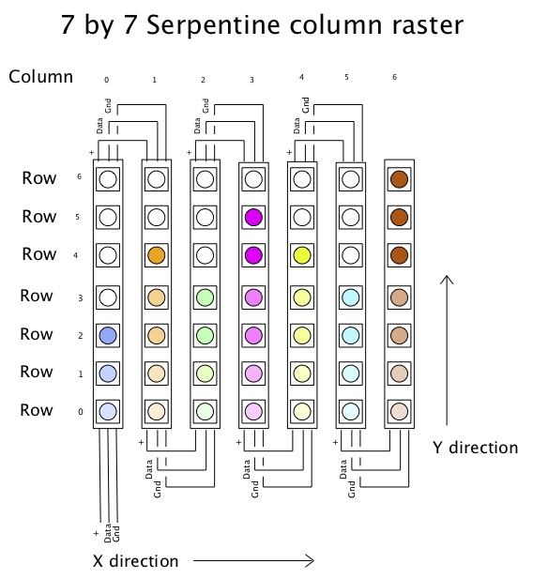
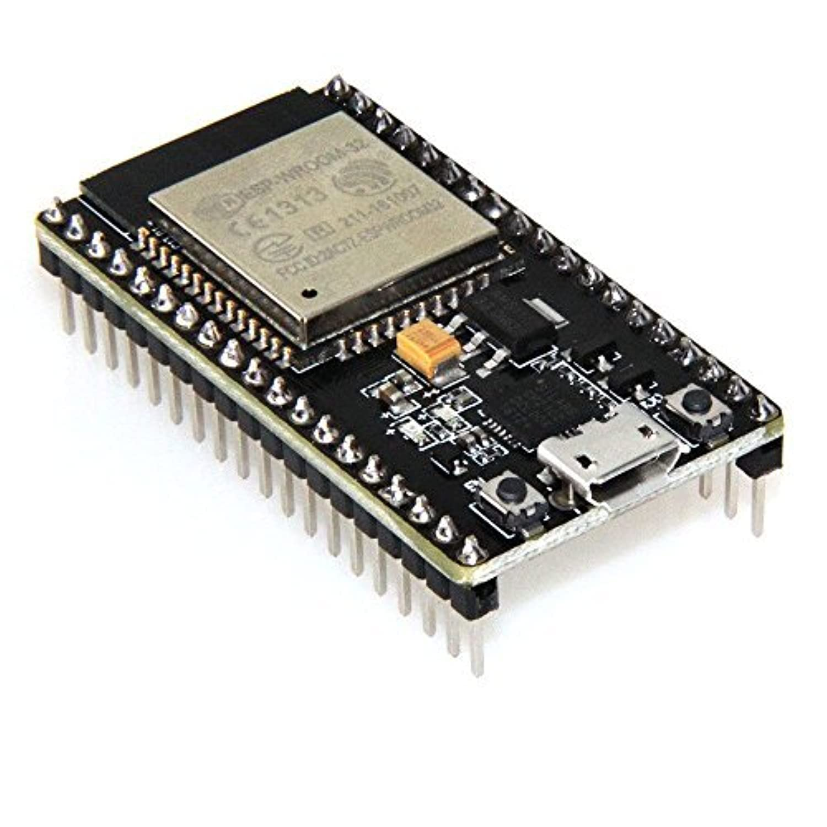
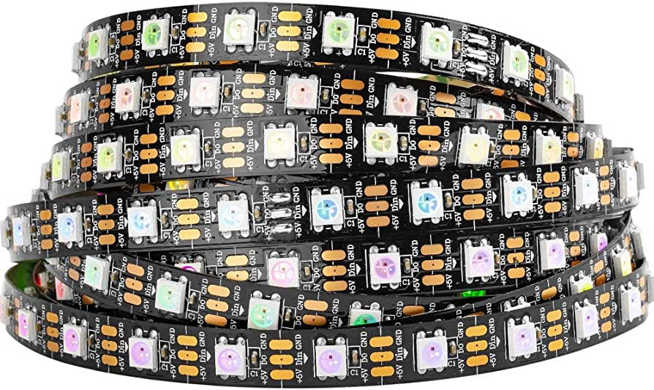
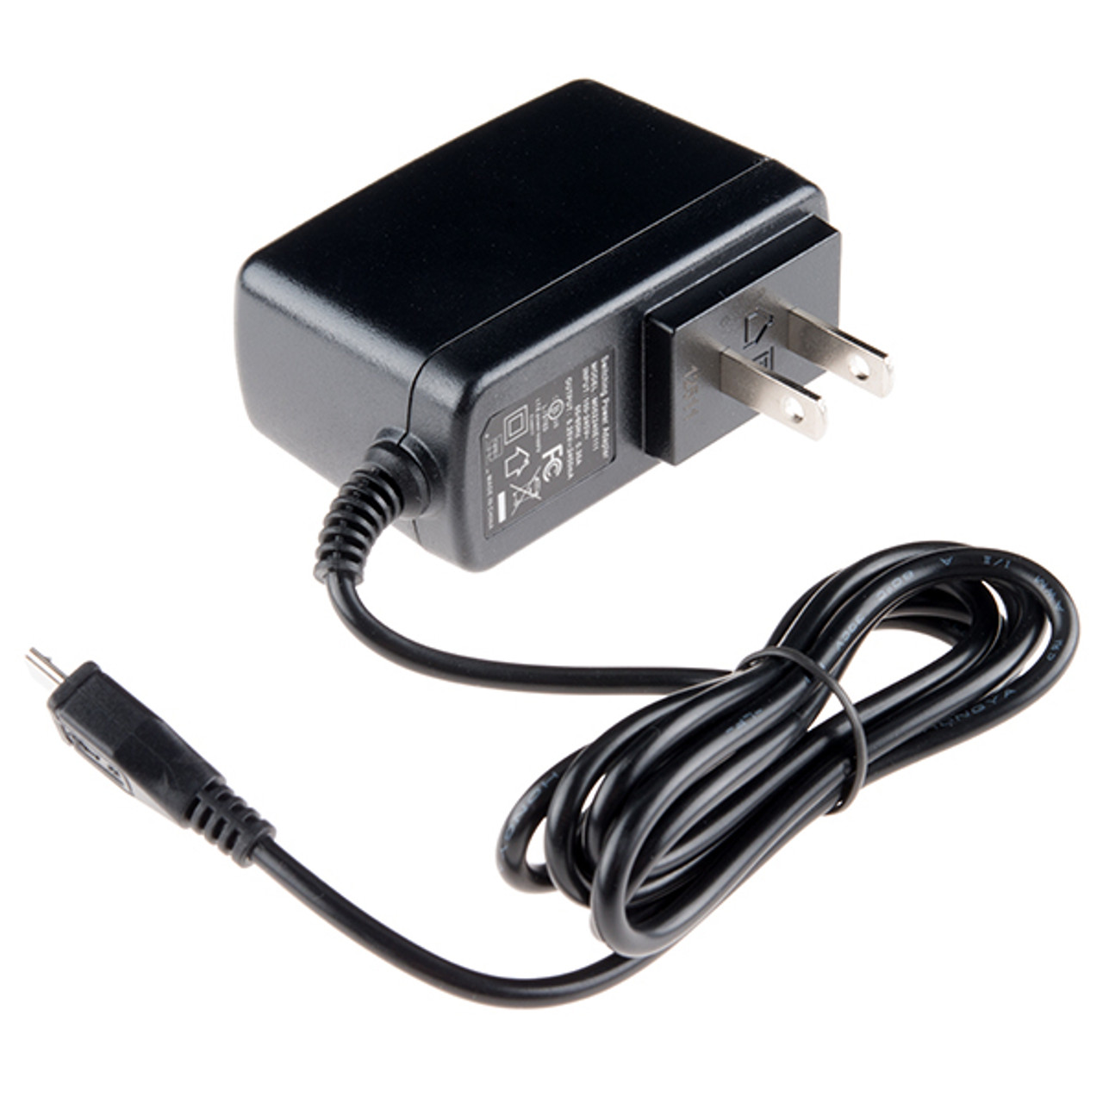
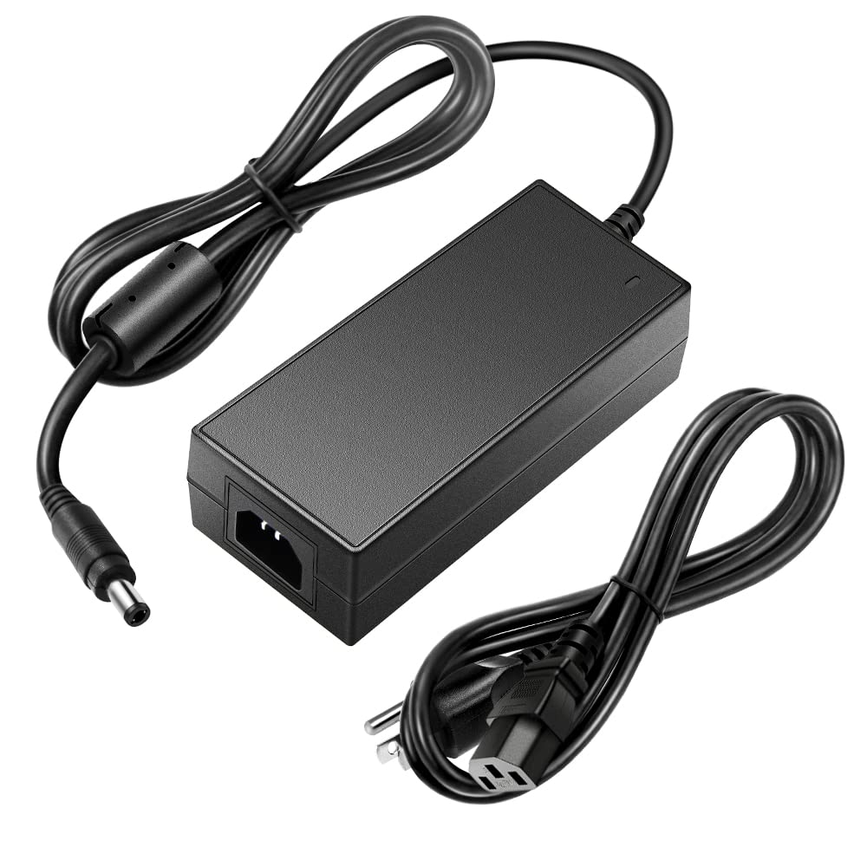
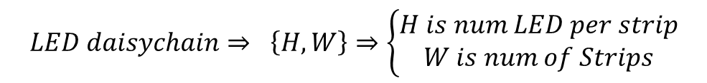
General Wiring Layout
Block Level Diagram
Serpentine Layout
DATA
GND
Power
Power
$$LED daisychain⇒ \left\{H, W\right\}⇒\left\{\begin{aligned}H is num LED per strip \\ W is num of Strips\end{aligned}\right.$$
$$\left\{H_{sign}, W_{sign}\right\}⇒\{13, 15\}⇒195 LEDs per daisychain$$
$$\left\{H_{totem}, W_{totem}\right\}⇒\{19, 10\}⇒190 LEDs per daisychain$$

Slide 6
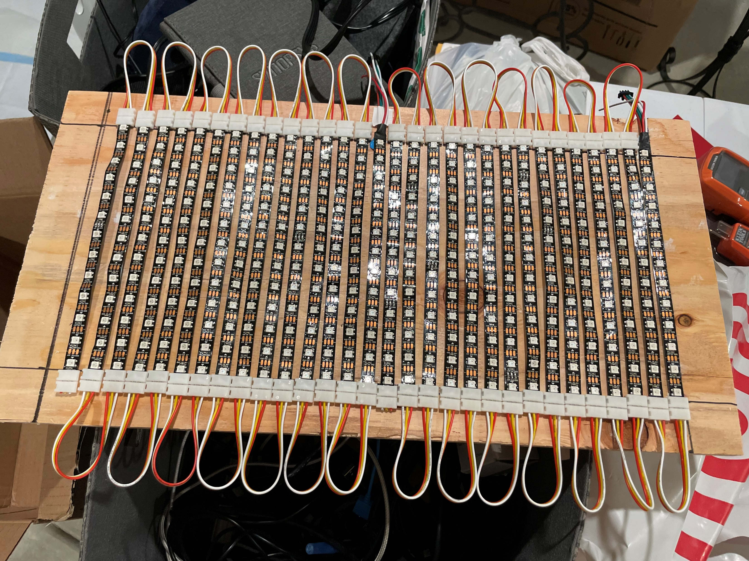
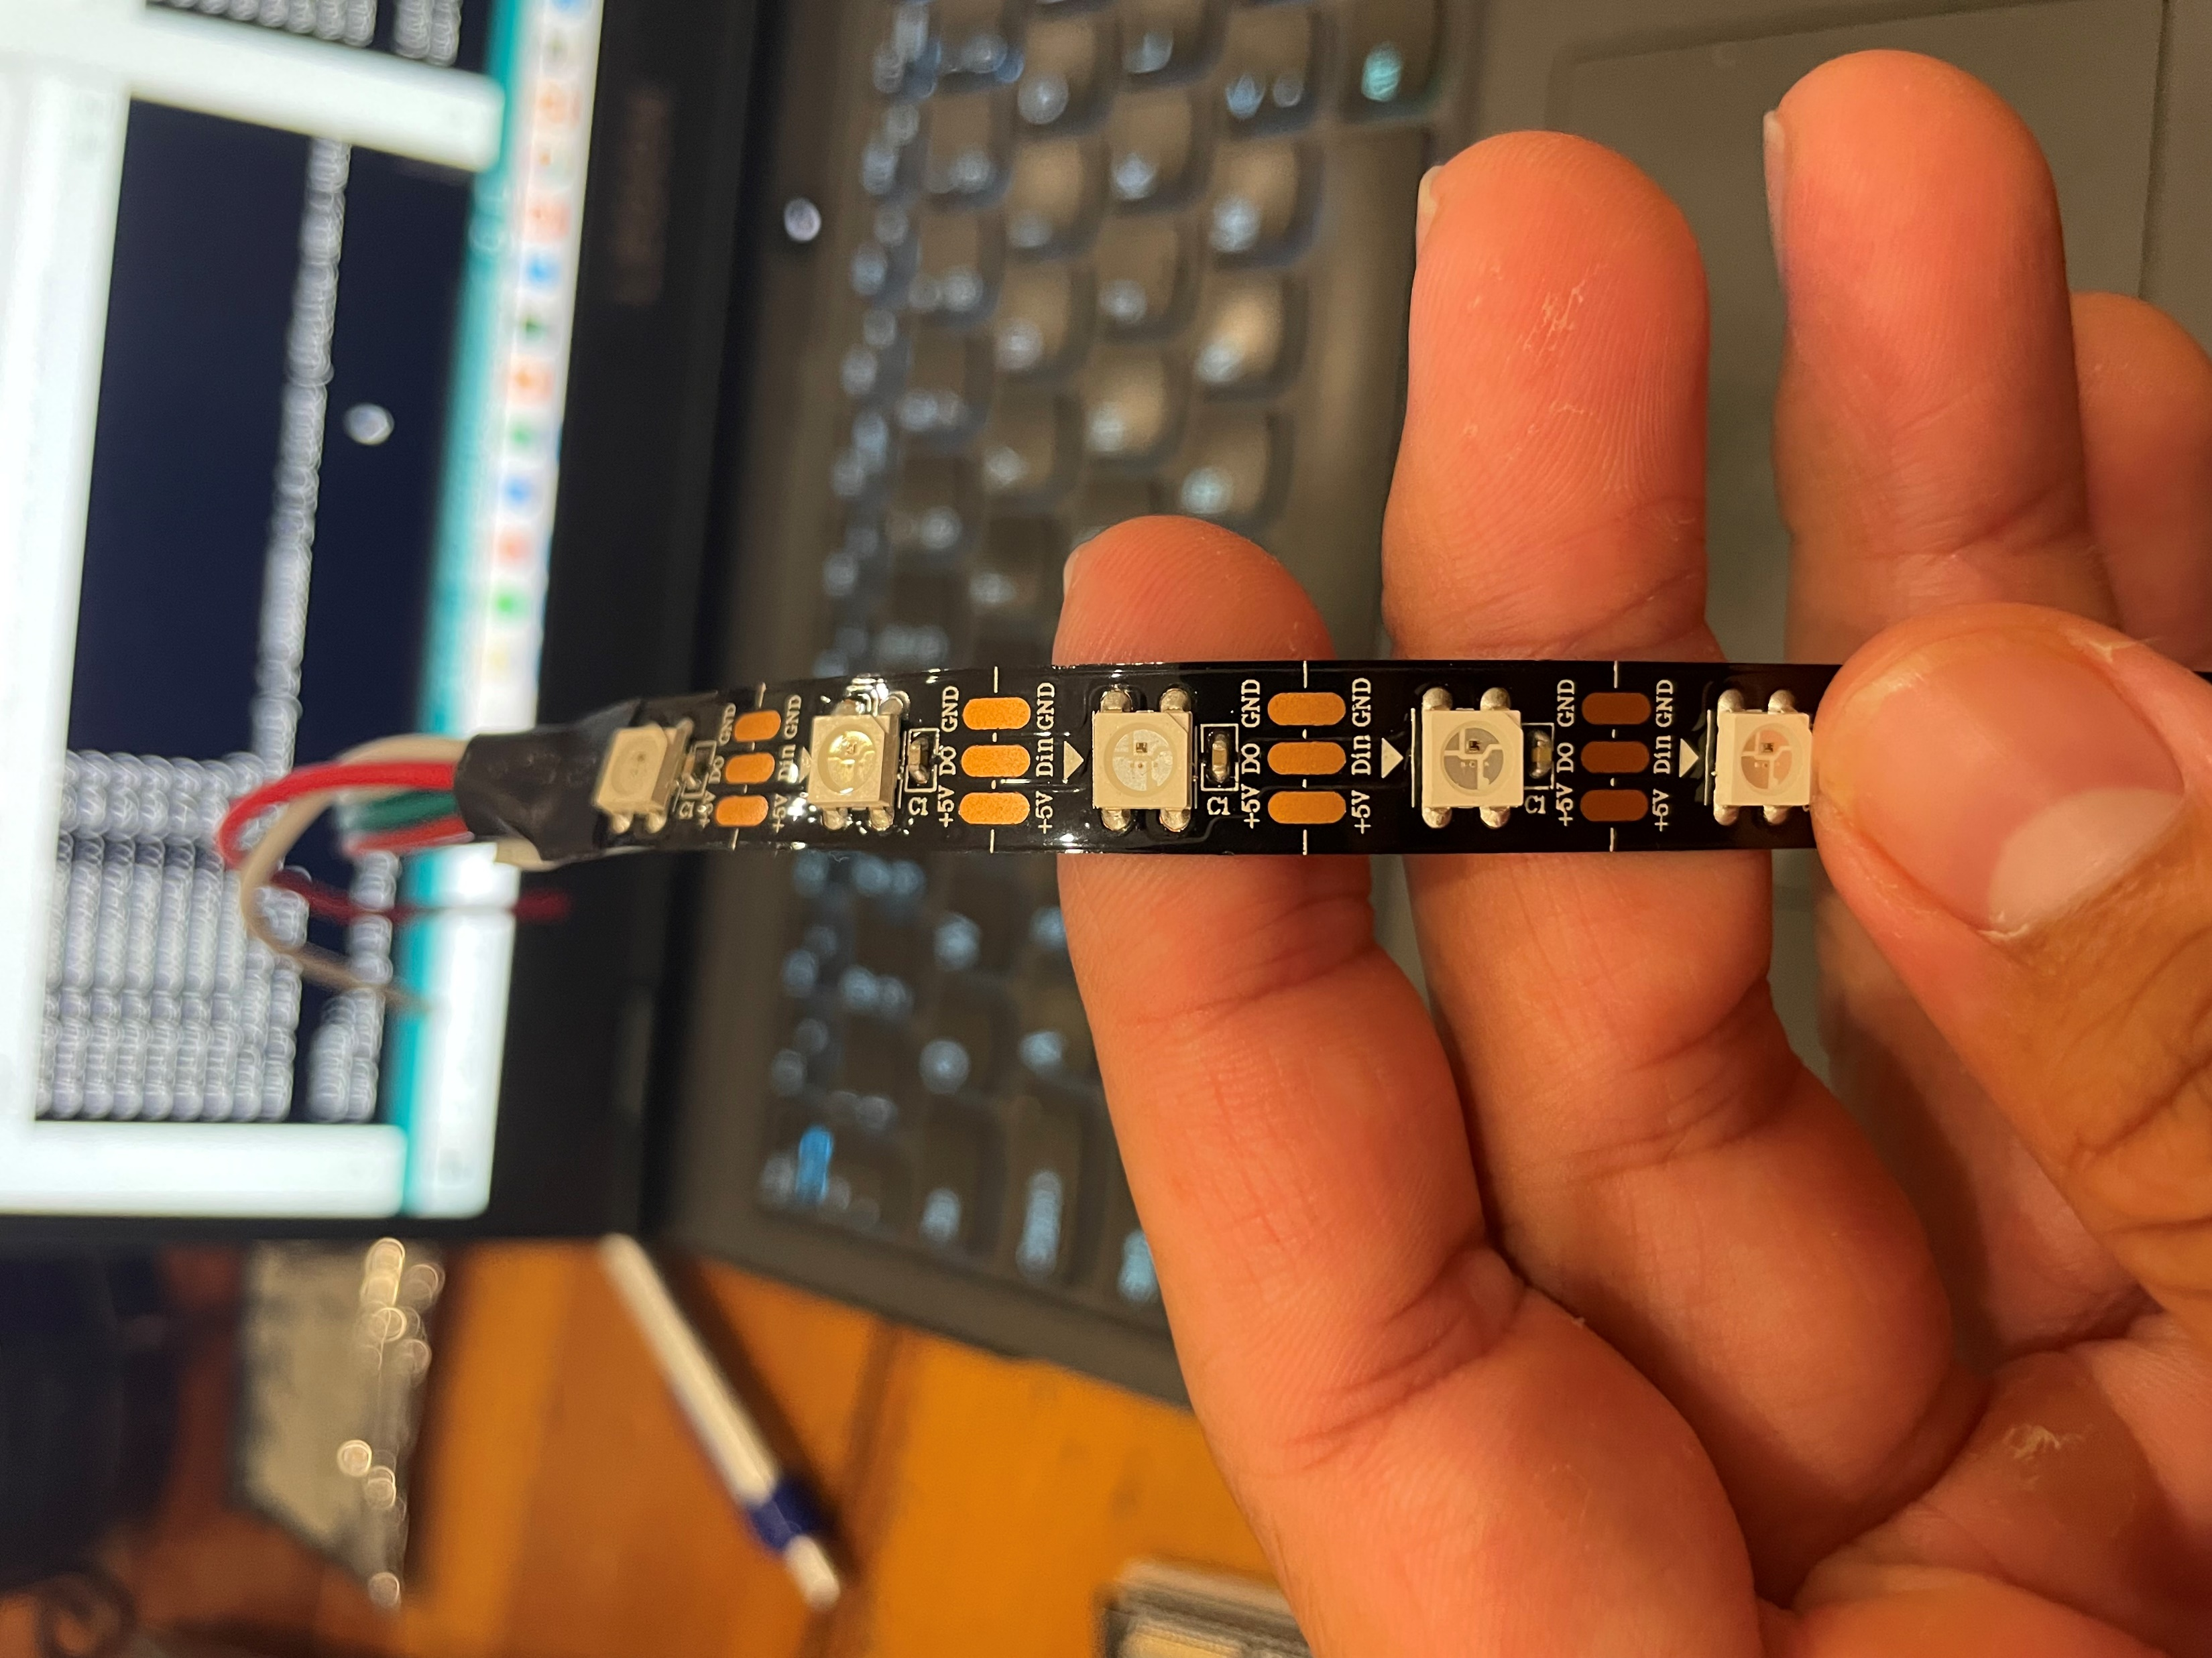
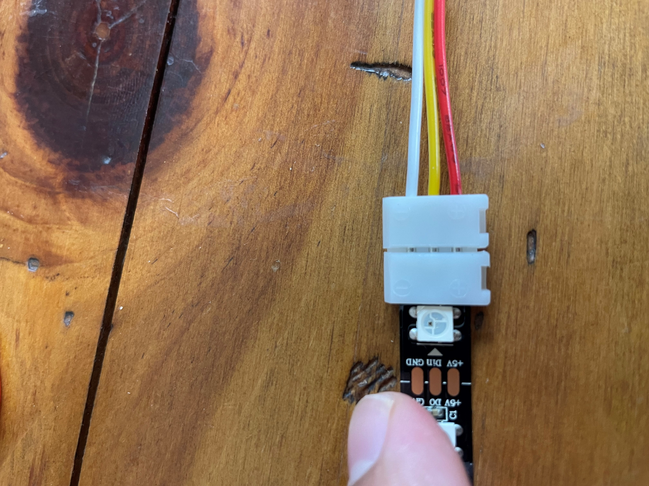
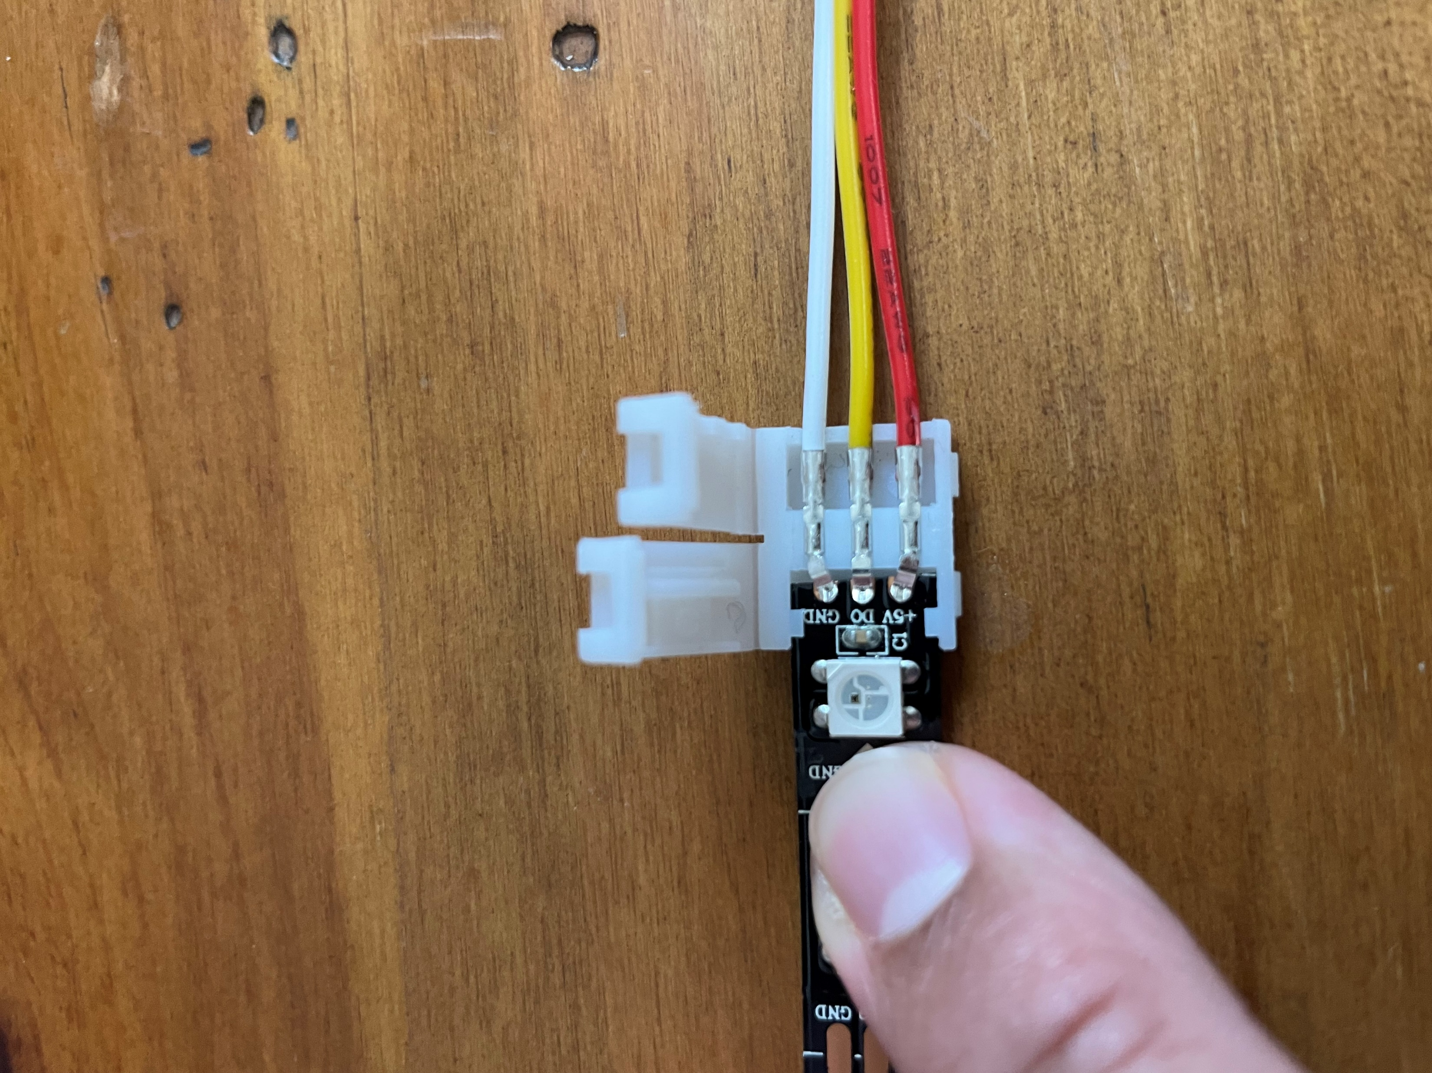
Things to look out for | Dust, Electrical contacts, etc.
Open
Closed

Slide 7
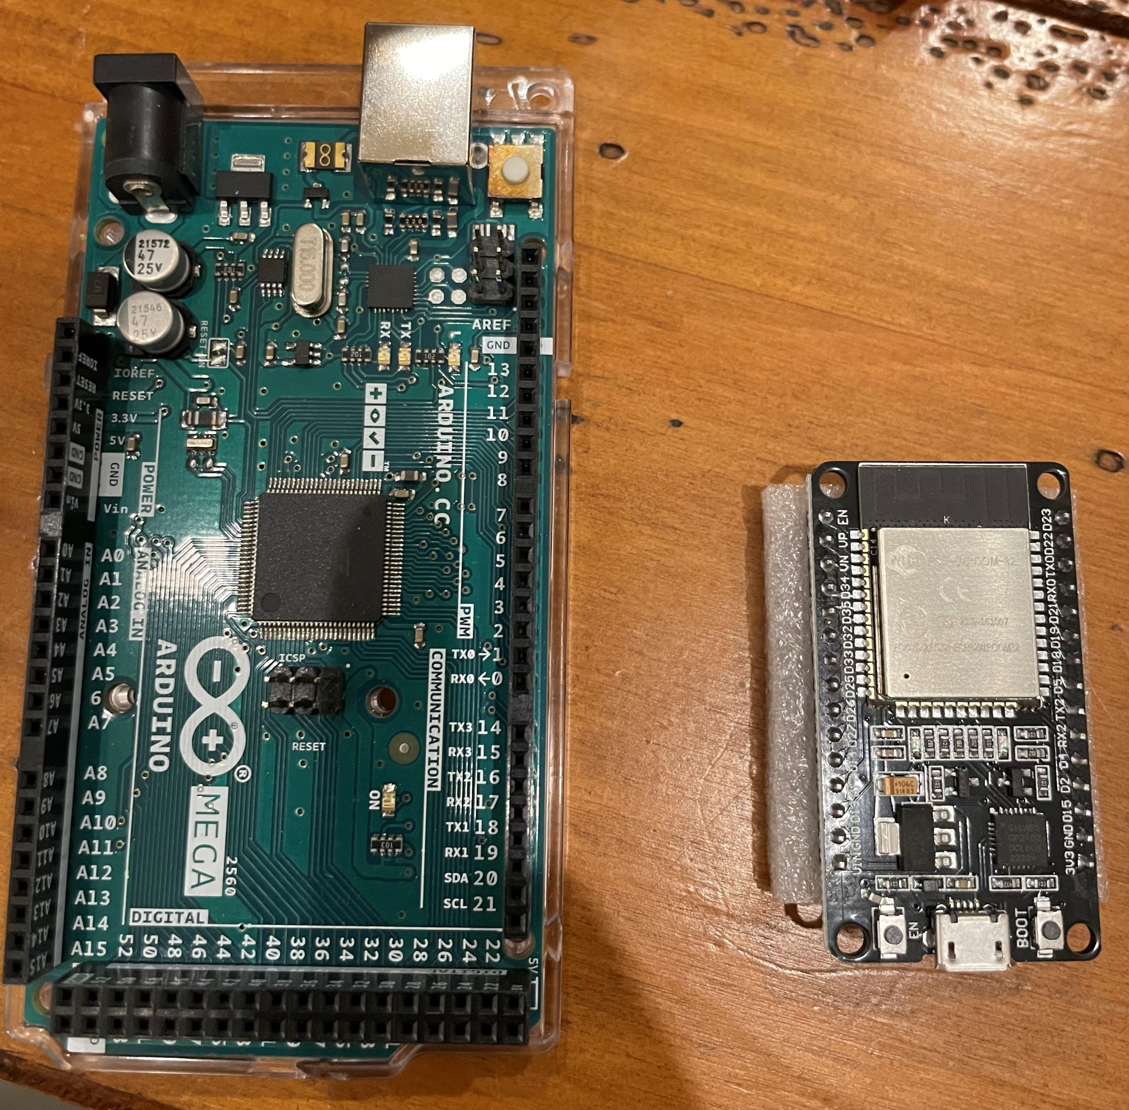
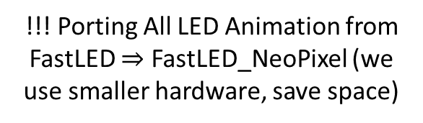
Progress Thus Far (7/20)
Electronics Progress
% of est. work
LED Panel | LED Cutting (25%) | Wiring (50%) | Gluing (20%) | Protect (5%)
NO (9%) | Done | Done
YES (14%) | Done | Done | Done
WAIT (18%) | Done
MAYBE (22%) | Done
Totems (x4) (37%) | Done
% of
LED strips
!!! Porting All LED Animation from FastLED $⇒$ FastLED_NeoPixel (we use smaller hardware, save space)
Software Progress
LED Animation
Base animation done
Port to the new library IP
Bells and whistles (last priority)
BLE Stack
Ping Pong done
Orchestrator BLE flow IP
Integration E2E
Button received
Sanity testing E2E IP
Final integration E2E (not yet)
General Notes
Hosting volunteer days in Sacramento for general build
Experimenting with Polyurethane as an insulating material to protect electrical contacts
Number of outlets needed (29); Power strips, and extension chords - who can bring some?
Need a volunteer to help me on the playa

